Slide 1
MEASURING INSTRUMENTS
Screw Gauge and Vernier Callipers 3D models

Slide 2
Project made by:
A. Anish
Ajit Shankar
Budaraju Vishal Datta
G. Sai Sravya
Kartik Srinivas
ES20BTECH11001
ES20BTECH11003
ES20BTECH11009
ES20BTECH11013
ES20BTECH11015

Slide 3
Index
Genesis
Complexity
Printer Settings and Important Notes
Optimisation
Screw Gauge and Printing Data
Screw Gauge Final Estimates
Vernier Calliper and Printing Data
Vernier Calliper Final Estimates
References
Contributions

Slide 4
Genesis of this project
Our team decided to make a project which would not just be a model of something but also could be used in the engineering classroom.This, coupled with our self learnt knowledge of Assembly and limitations on material usage brought us to the idea of Scientific Instruments!

Slide 5
Complexity of the project
Manufacturing of Scientific Measuring Instruments requires several different parts with accurate sizes which need to be put together perfectly.That being said,this project had 10 part files, 2 subassemblies and a final assembly for Screw Gauge, 10 part files, 2 subassemblies and a final assembly for Vernier Callipers.

Slide 6
Printer Settings and Important Notes
Software used to estimate Printing Data is GrabCAD
The Printer Template used for all the GrabCAD Printing Data is Fortus 450mc.
The orientation images in GrabCAD are kept in as a hyperlink for each of the part in the table. On clicking the part names you can view the images.
Part files have been modelled on Solid Edge 2021, Solid Edge 9 ,Solid Edge 6 etc.depending on the team member that modelled it.
We learnt basic Solid Edge Assembly (plane ,axis alignment) from several websites and from here : Solid Edge assembly

Slide 7
Optimisation
We have used shelling to optimise printing time.The infill used is hexagram for the stronger,moving parts(eg:Thimble Subassembly) and also for the pieces which have screws drilled into them(to provide good attachment).
Solid is used for the strongest parts.
For the relatively weaker pieces sparse infill has been used for faster printing and less material usage.

Slide 8
Optimisation
4) Shell thickness for stronger pieces has been improved to 0.12 inches to improve strength.
Note: 0.12 inches is a multiple of 0.06 inches which is the nozzle diameter,this prevents voids
(for more information see references)
5) Printing Orientations have been calculated to minimize support material.

Slide 9
Screw Gauge

Slide 10
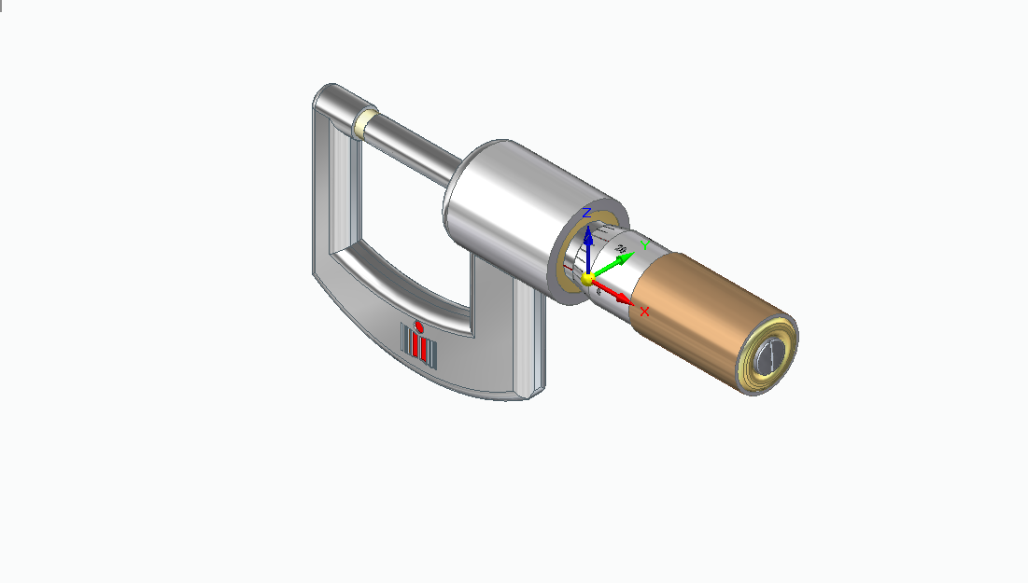
Model Pic for Screw gauge

Slide 11
Screw Gauge Printing Data

Slide 12
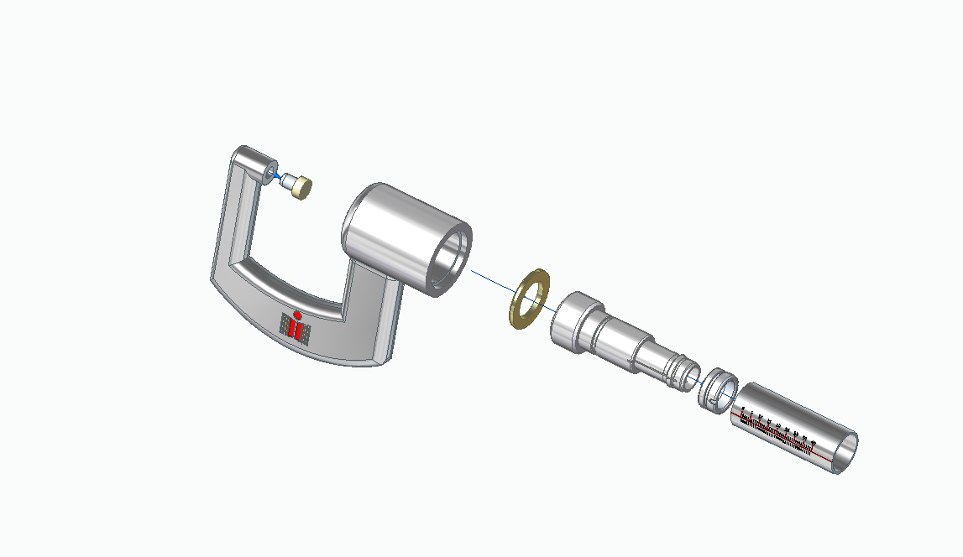
Exploded View of Frame Subassembly

Slide 13
Frame Subassembly
Part | Infill | Body Thickness(Inches) | Print Time | Model Material | Support Material
Anvil | Hexagram (50%) | 0.06 | 4 minutes | 0.02 | 0.009
Frame | Solid fill | - | 1 hour 21 minutes | 1.559 | 0.564
Plate | Hexagram (45%) | 0.06 | 2 minutes | 0.034 | 0.021
Stem | Hexagram (50%) | 0.06 | 1 hour 37 minutes | 0.558 | 0.639
Binder | Solid fill | - | 9 minutes | 0.052 | 0.054
Barrel | Hexagram (54%) | 0.12 | 11 minutes | 0.071 | 0.015
Total |  |  | 3 hours 22 minutes | 2.294 | 1.302
Click on part file to see their printing orientations

Slide 14
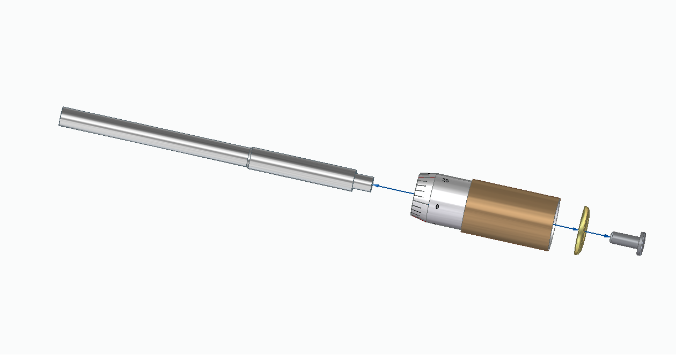
Exploded View of Thimble subassembly

Slide 15
Thimble Subassembly
Part | Infill | Body Thickness | Print Time | Model Material | Support Material
Thimble | Hexagram (54%) | 0.12 | 30 minutes | 0.383 | 0.043
Spindle | Hexagram (54%) | 0.12 | 55 minutes | 0.236 | 0.009
Washer | Hexagram (54%) | 0.12 | 3 minutes | 0.035 | 0.019
Screw | Hexagram (54%) | 0.12 | 6 minutes | 0.021 | 0.01
Total |  |  | 1 hour 34 minutes | 0.675 | 0.081
Click on part file to see their printing orientations

Slide 16
Final Estimates of Screw Gauge
Time Taken = 3h 32m + 1h 34m = 5 hours 06 minutes
Model Material Used = 2.294 + 0.675 = 2.969 in³
Support Material Used = 1.302 + 0.081 = 1.383 in³

Slide 17
Vernier Callipers

Slide 18
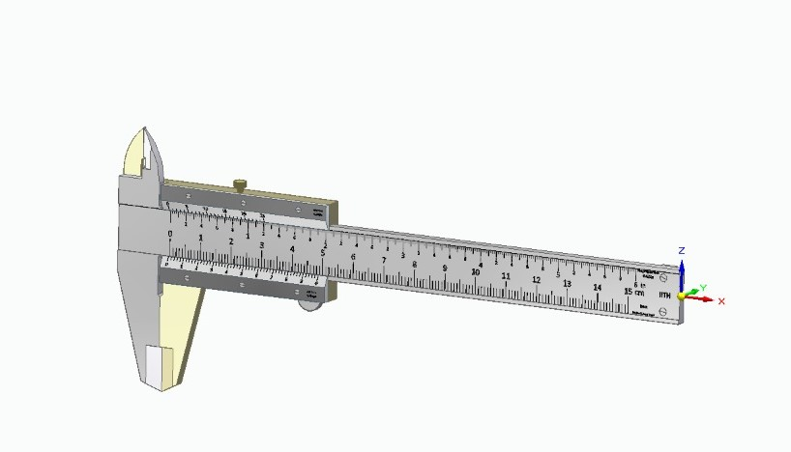
Model Pic for Vernier Callipers

Slide 19
Vernier Callipers Printing Data

Slide 20
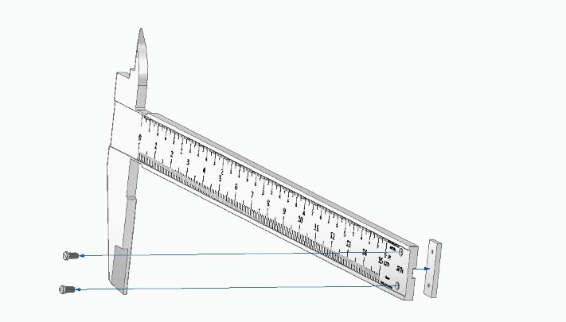
Exploded View of Linear scale subassembly

Slide 21
Linear Scale subassembly
Part | Infill | Body thickness (Inches) | Print time | Model Material | Support Material
Linear Scale | Hexagram (54%) | 0.12 | 27 minutes | 0.633 | 0.198
Protrusion | Hexagram (54%) | 0.12 | 3 minutes | 0.019 | 0.01
Lock Screw | Hexagram (54%) | 0.12 | 4 minutes | 0.021 | 0.022
Total |  |  | 34 minutes | 0.673 | 0.23
Click on part file to see their printing orientations

Slide 22
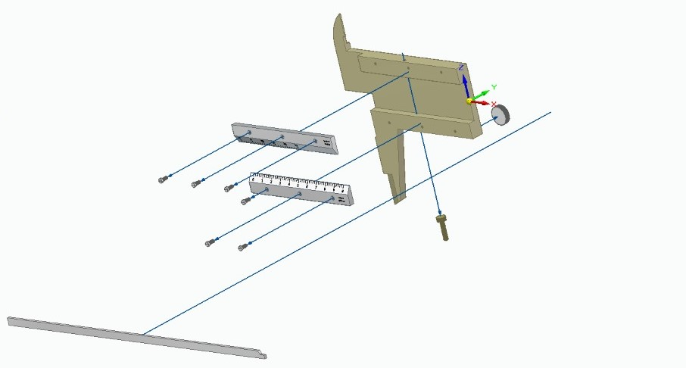
Exploded view of Vernier scale subassembly

Slide 23
Vernier Scale Subassembly
Part name | Infill | Body Thickness (Inches) | Print time | Model Material(in³) | Support Material(in³)
Sliding Jaw | Hexagram (60%) | 0.12 | 19 minutes | 0.524 | 0.151
Vernier Scale-2 | Sparse Double-Dense (50%) | 0.06 | 4 minutes | 0.063 | 0.03
Vernier Scale-1 | Sparse Double-Dense (50%) | 0.06 | 4 minutes | 0.063 | 0.03
Finger Hook | Hexagram (54%) | 0.12 | 2 minutes | 0.016 | 0.009
Strip for Depth | Sparse Double-Dense (36%) | 0.12 | 3 minutes | 0.051 | 0.029
Total |  |  | 32 minutes | 0.717 | 0.249
Click on part file to see their printing orientations

Slide 24
Final Estimates of Vernier Calliper
Time Taken = 32m+34m = 1 hour 6 minutes
Model Material Used = 0.673 + 0.717 = 1.39 in³
Support Material Used = 0.23+0.249 = 0.479 in³

Slide 25
References

Slide 26
References Screw Gauge
Different parts of a screw Gauge and the construction
The Ultimate Guide To Micrometer Screw Gauge
Micrometer: 5 Types of Micrometer Screw Gauge [Pictures-PDF]
Micrometer Screw Gauge: Parts of a Micrometer Screw & Functions

Slide 27
References Vernier Callipers
Different parts of a vernier caliper and the construction
Vernier Caliper | Parts, Types, Working, Least Count, Errors
Next Post Manufacturing Material & Parts of a Vernier Caliper Assembly
Vernier Caliper: Parts, Principle, Formula, LC, Range, Resolution, Applications [PDF]
MEASURING INSTRUMENTS CATALOG No.E2020 (e-Book) Details

Slide 28
References on Printing
Designing for FDM Production Parts
Create an FDM Part with Different Infill Patterns & Densities

Slide 29
Contributions

Slide 30
K.Srinivas - Barrel_k.par, Spindle_k.par, washer_k.par, subassembly_thim.asm, Exploded Views, thimble subassembly STL files, Optimisation(Infill and Printer Settings), Printing Data for Thimble subassembly, Presentation.
G.S.Sravya - linear scale_sravya.par, protrusion_sravya.par, screw on linear scale_sravya.par, screw on vernier scale_sravya.par, lock screw_sravya.par, Asm1.asm(subassembly of linear scale), Asm2.asm(subassembly of vernier scale), Vernier Calliper.asm, STL files and printing data of the mentioned par files.
A.Anish - Anvil.par, frame1.par, plate1.par, screw1.par, Stem1.par, Frame-sub_assembly.asm, Frame-sub_assembly STL files, Frame-sub_assembly printing data, Presentation.

Slide 31
B. Vishal Datta - Thimble1.par, Binder-1.par, Screw_Gauge_Final.asm, Presentation-
Theme, Presentation.
Ajit Shankar - Sliding Jaw_Ajit.par, Vernier Scale-1_Ajit.par, Vernier Scale-2_Ajit.par, Finger Hook_Ajit.par, Strip for Depth Measurement_Ajit.par, Printing Data for Vernier Scale Subassembly.

Slide 32
THANK YOU !

